Slide 1
Introduction to Machine Learning

Slide 2
Prerequisites
For Machine Learning Course we recommend that students meet the following
prerequisites:
Basic programming skills ( Python)
Basics of probability & statistics
Artificial Intelligence

Slide 3
References
Text Books:
1. Tom M. Mitchell, Machine Learning, India Edition 2013, McGraw Hill Education.
2. Ethem Alpaydın, Introduction to machine learning, Third Edition, MIT press,2014

Slide 4
What is Machine Learning?
(Layman’s term)

Slide 5

Human can learn from past experience and make decision of its own

Slide 6
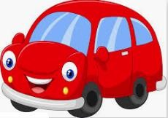
What is this object?

Slide 7
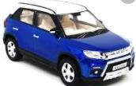

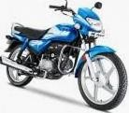
What is this object?
CAR
CAR
BIKE
It is a CAR
BIKE

Slide 8

Let us ask the same question to him
What is this object?

Slide 9


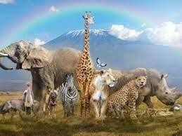
Let us ask the same question to him
?
What is this object?

Slide 10
[ But, he is a human being. He can observe and learn ]

Slide 11

Let us make him learn
show him

Slide 12
Let us make him learn
CAR
show him
CAR
BIKE
BIKE

Slide 13
Let us ask the same question now
What is this object?
CAR
CAR
BIKE BIKE
Past experience
10

Slide 14

Let us ask the same question now
CAR
What is this object?
CAR
CAR
BIKE BIKE

Slide 15

What about a Machine ?
Machines follow instructions
[ It can not take decision of its own]

Slide 16
What about a Machine ?
We can ask a machine
To perform an arithmetic operations such as
Addition
Multiplication
Division
Machines follow instructions

Slide 17
What about a Machine ?
Comparison
Print
Plotting a chart
Machines follow instructions

Slide 18
What is Machine Learning?
[ We want a machine to act like a human]

Slide 19

What is Machine Learning?
[ to identify this object.]

Slide 20
What is Machine Learning?
Price in 2025?
[ predict the price in future]

Slide 21
What is Machine Learning?
I made met him yesterday
[ Natural Language understand, and correct grammar ]

Slide 22

What is Machine Learning?
recognize face
[ Recognize Faces ]

Slide 23
What is Machine Learning?
[ What do we do?
Just like, what we did to human, we need to provide experience
to the machine.
]

Slide 24
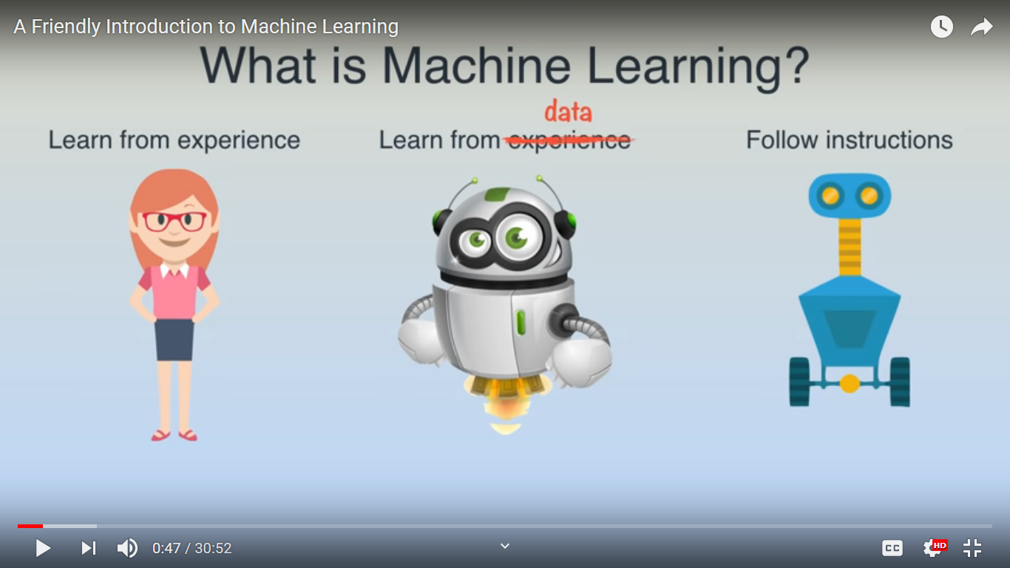
What is Machine Learning?
A computer program is said to learn from experience E with respect to some class of tasks T and performance measure P, if its performance at tasks in T, as measured by P, improves with experience E.

Slide 25
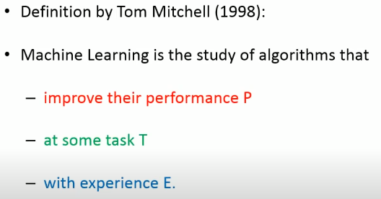

Slide 26
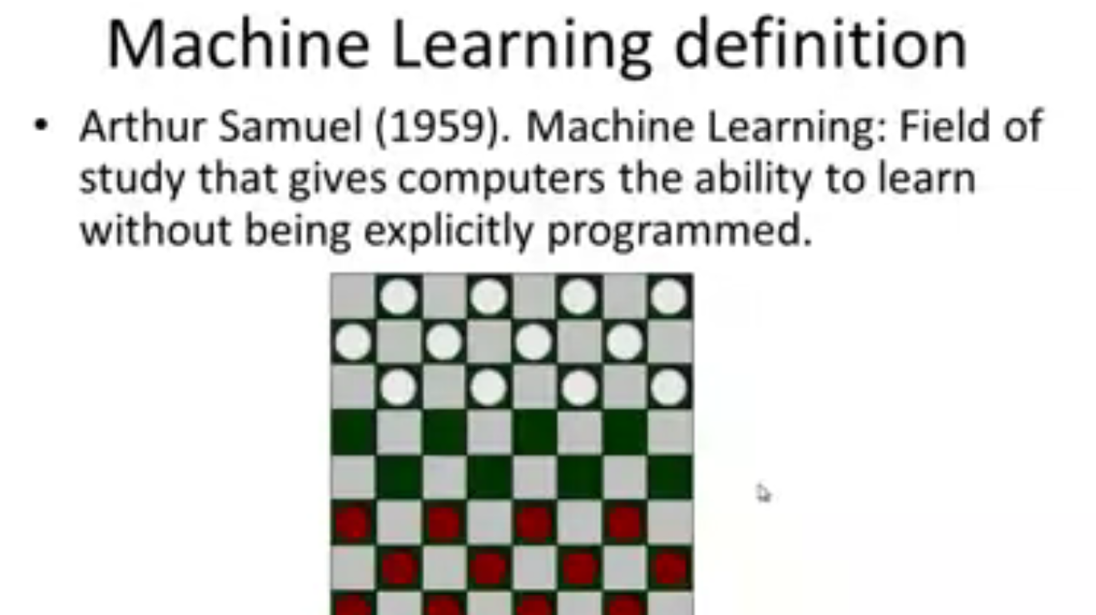

Slide 27
Machine learning and our focus
Like human learning from past experiences.
A computer does not have “experiences”.
A computer system learns from data, which represent some “past experiences” of an application domain.
Example: A credit card company receives thousands of applications for new cards. Each application contains information about an applicant,
age
Marital status
annual salary
outstanding debts
credit rating
etc.
Problem: to decide whether an application should approved, or to classify applications into two categories, approved and not approved.

Slide 28
Well-Posed Learning Problem
Definition: A computer program is said to learn from experience E with respect to some class of tasks T and performance measure P, if its performance at tasks in T, as measured by P, improves with experience E.
To have a well-defined learning problem, three features needs to be identified:
The class of tasks
The measure of performance to be improved
The source of experience

Slide 29
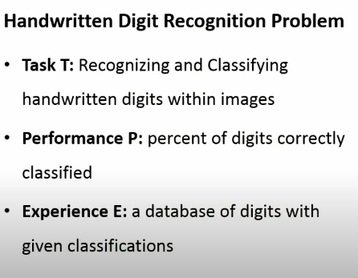


Slide 30
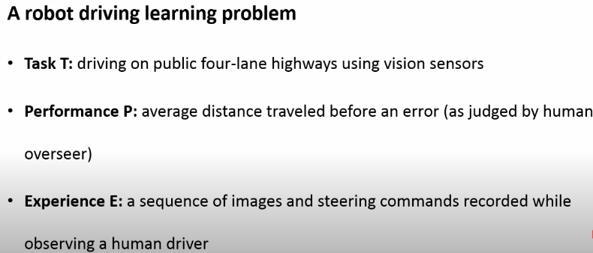

Slide 31
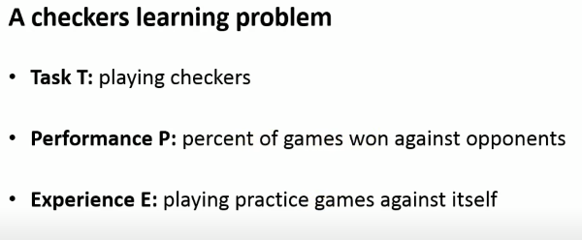

Slide 32
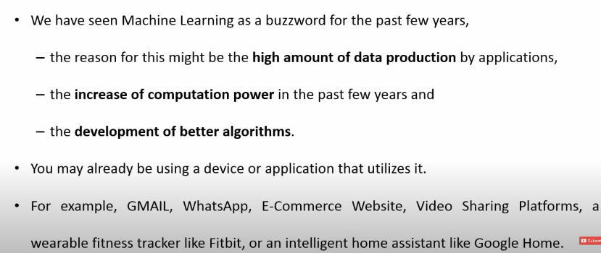

Slide 33
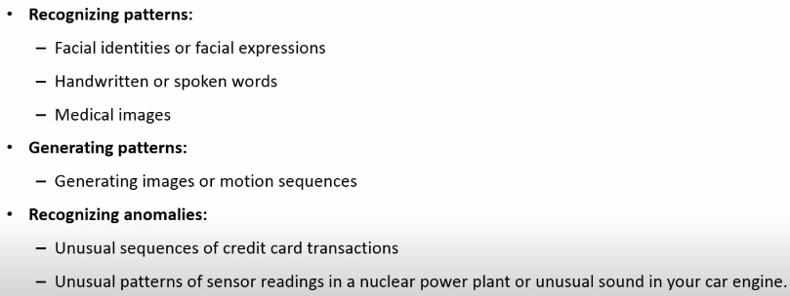
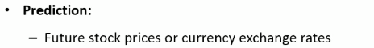
Applications of Machine Learning

Slide 35
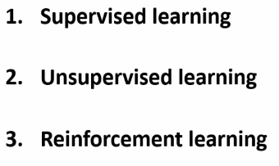

Slide 36
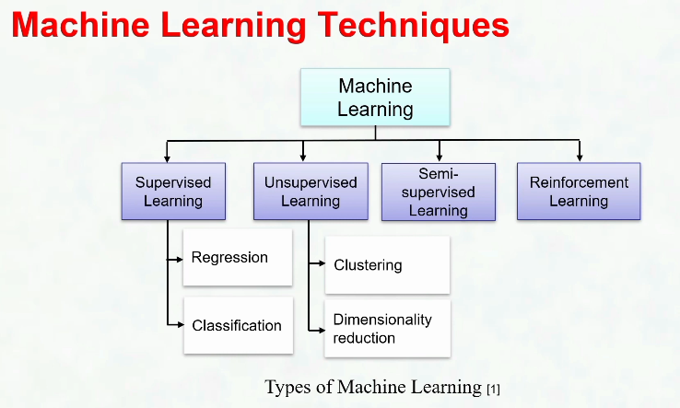

Slide 37
What is Supervised Learning?
CAR
+
CAR
₌ Training Dataset
BIKE
BIKE
Samples
Labels
[In supervised learning, we need some thing called a Labelled Training Dataset ]

Slide 38
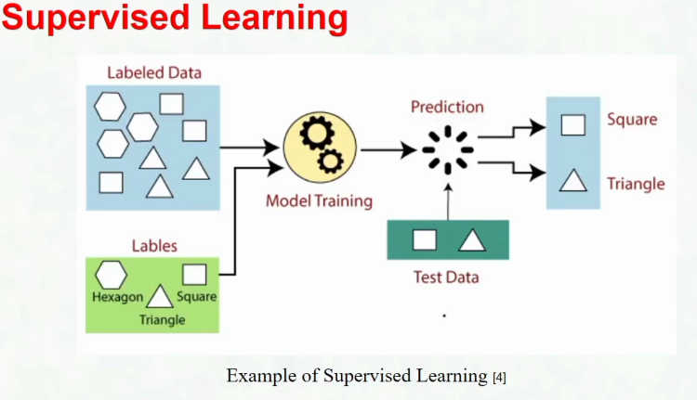

Slide 39
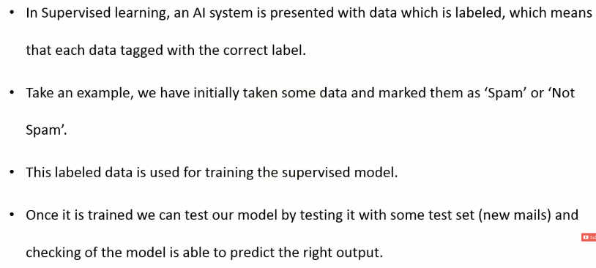

Slide 40
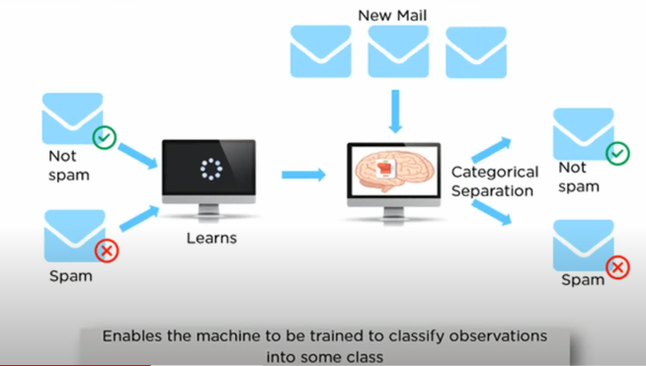

Slide 41
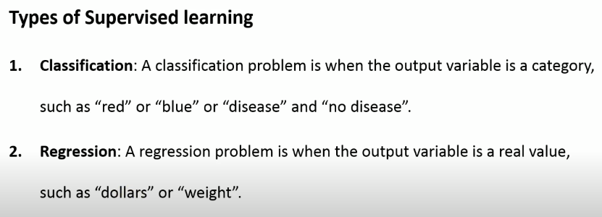

Slide 42
What is Unsupervised Learning
CAR
CAR
BIKE BIKE
Dataset
[ In the unsupervised learning, we do not need to know the labels or Ground truth values ]

Slide 43
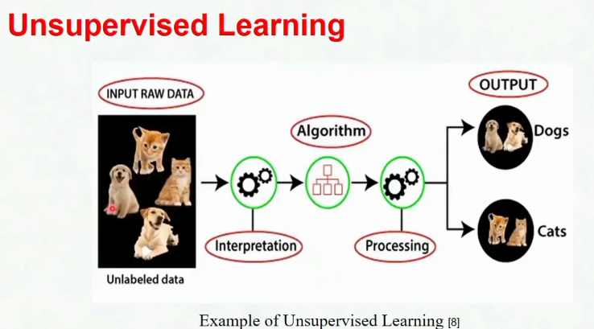

Slide 44
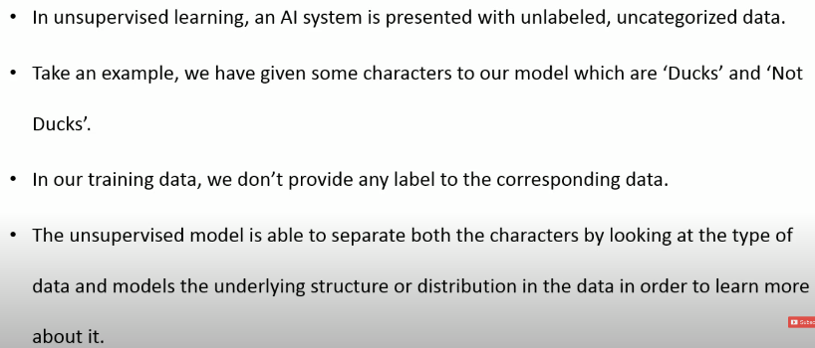

Slide 45
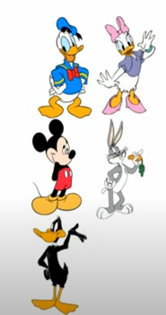
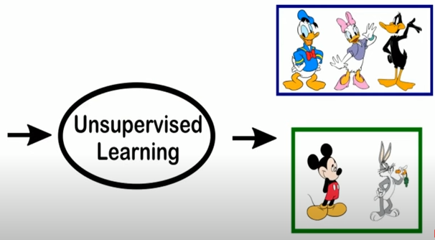

Slide 46
What is Unsupervised Learning
Clustering
Dataset
[ The task is to identify the patterns like group the similar objects together ]
39

Slide 47
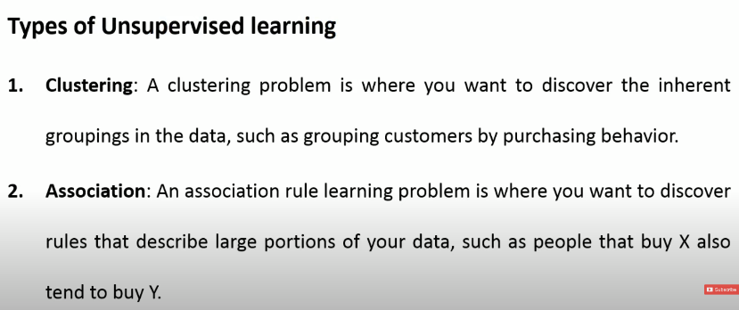

Slide 48
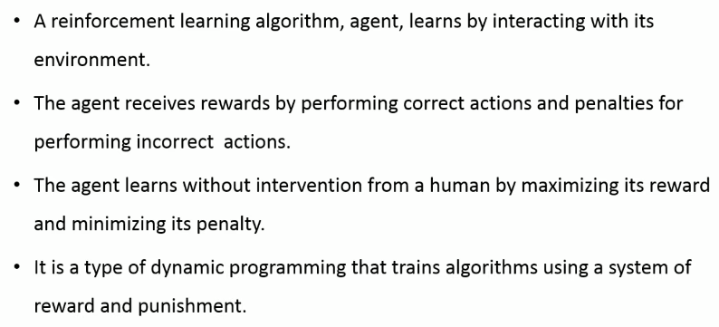

Slide 49
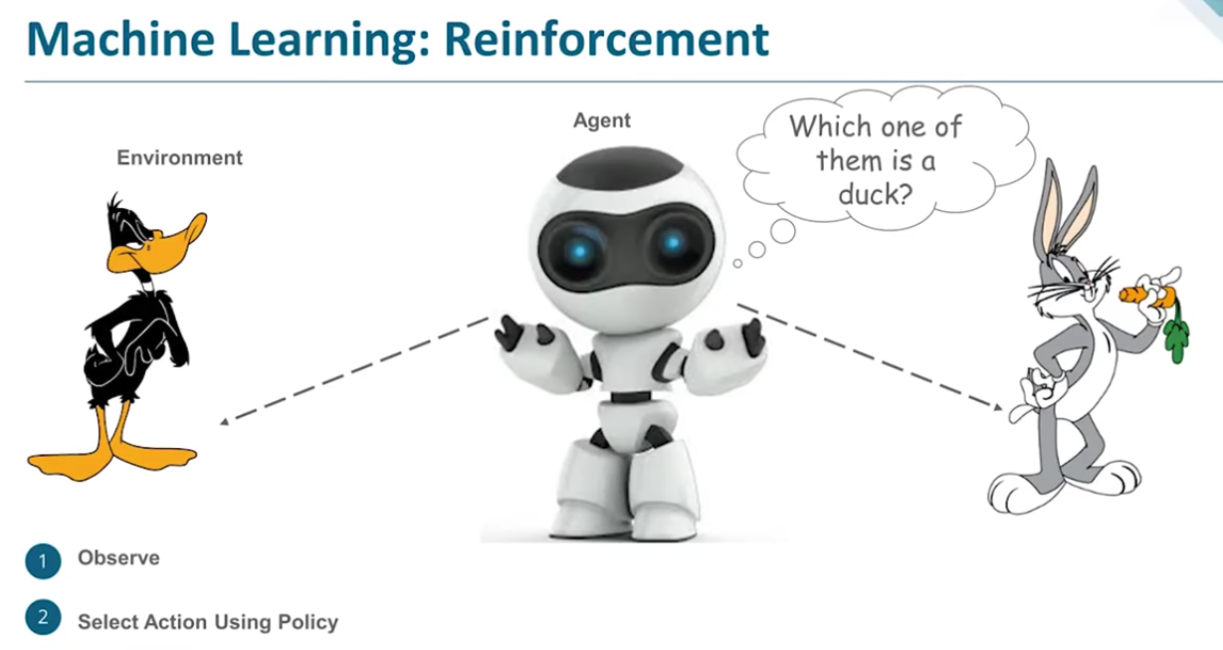

Slide 50
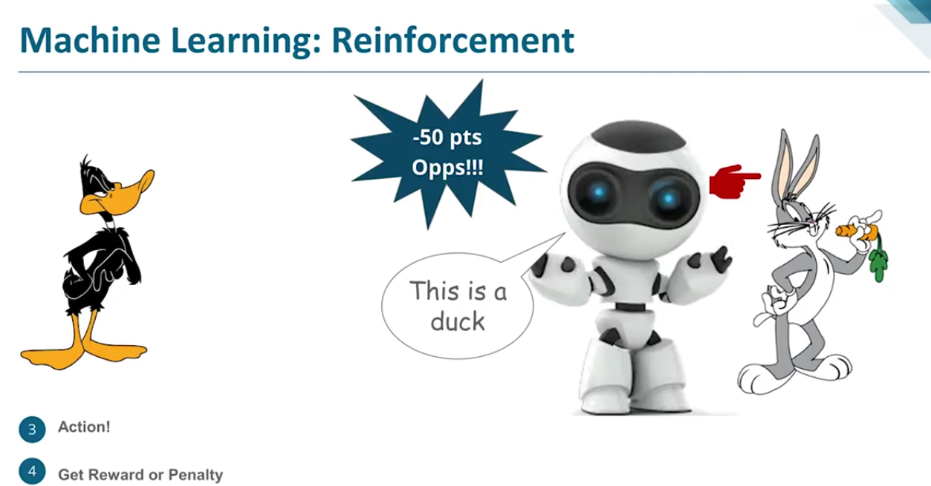

Slide 51
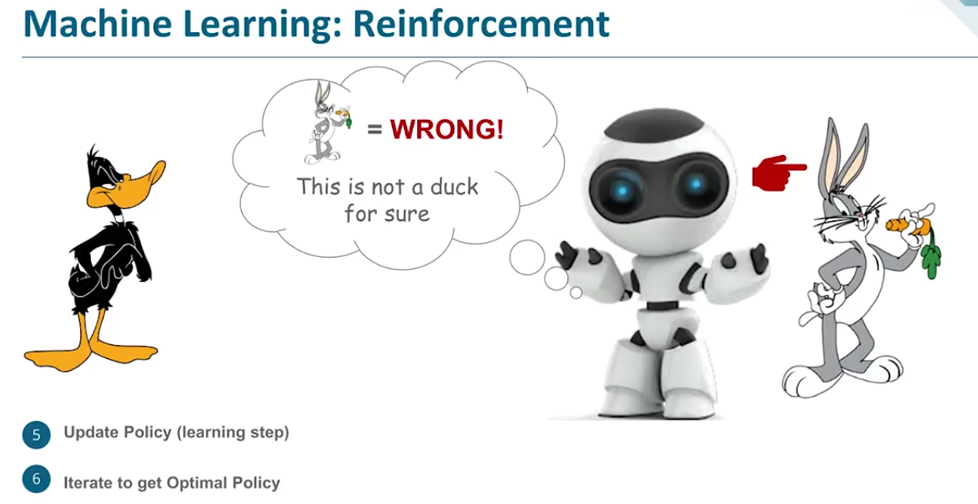

Slide 52
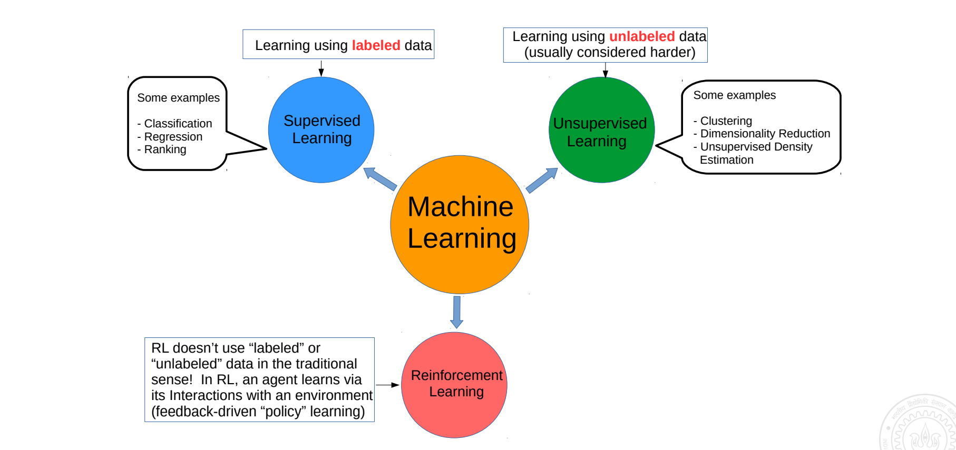

Slide 53
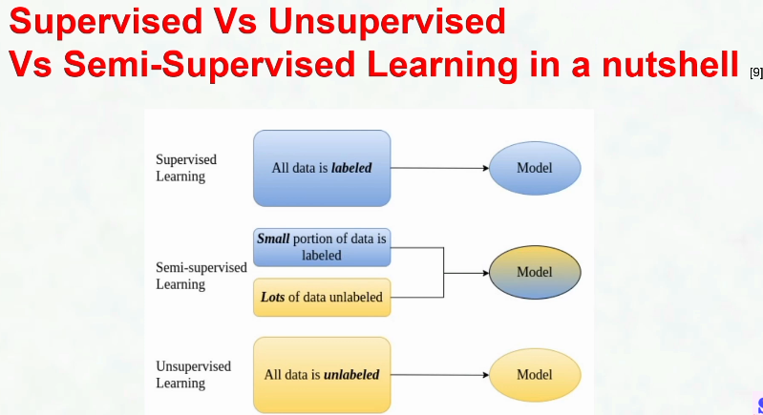

Slide 54
Applications of Machine Learning

Slide 55
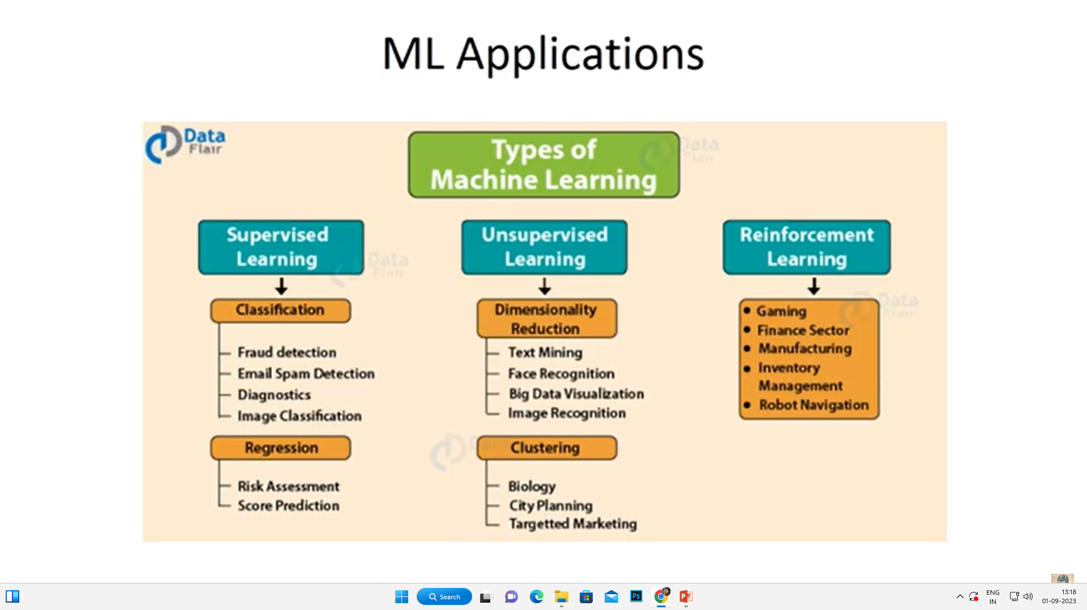

Slide 56
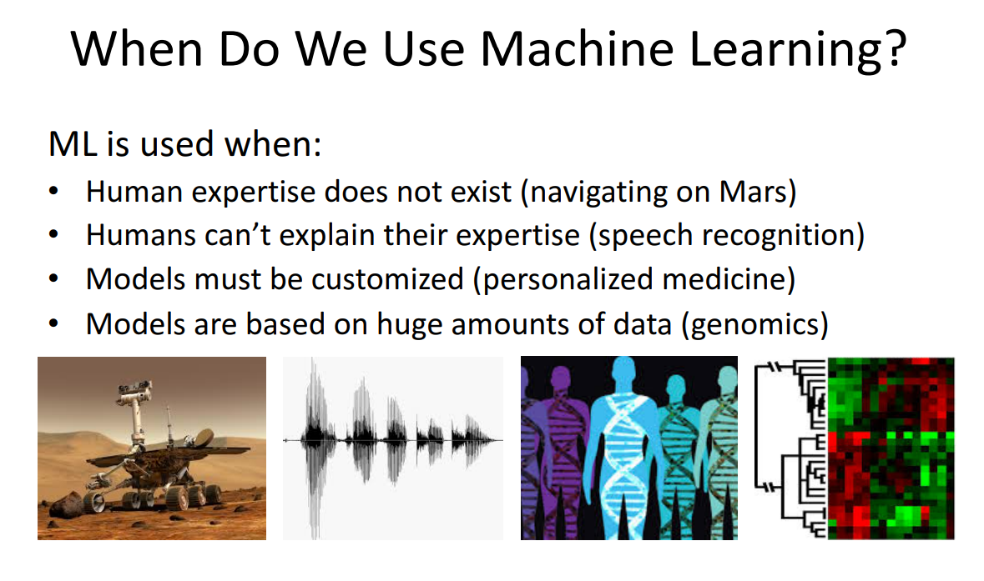

Slide 57
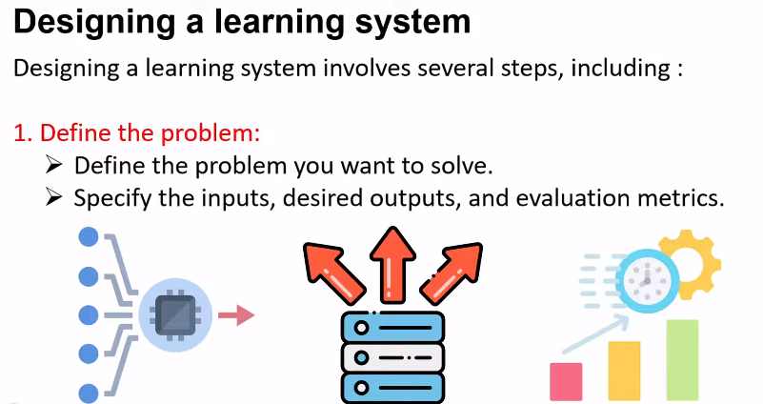

Slide 58

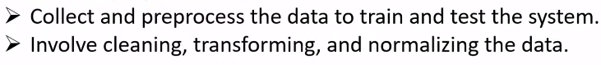




Slide 59
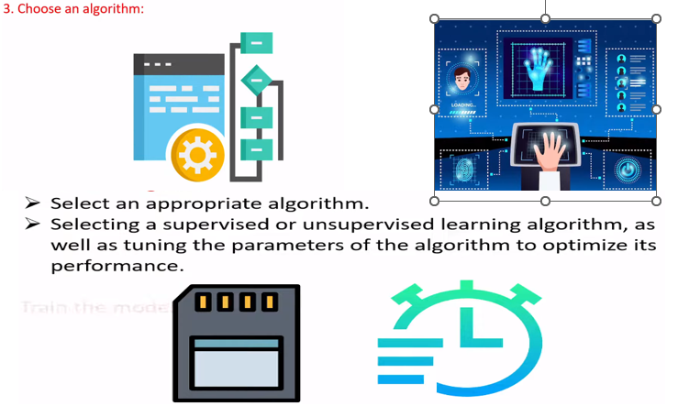

Slide 60
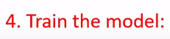

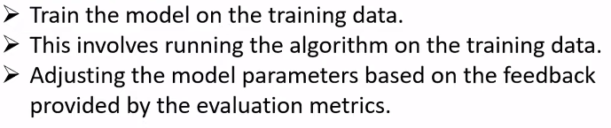
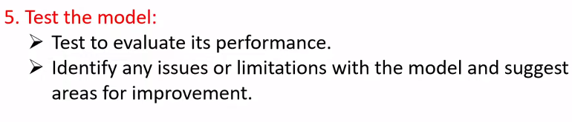


Slide 61

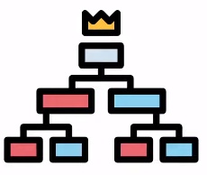
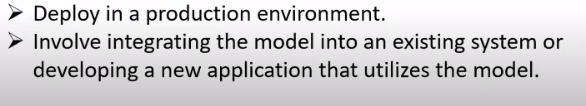



Slide 62
Issues in Machine Learning
What algorithms exist for learning general target functions from specific training examples? In what settings will particular algorithms converge to the desired function, given sufficient training data? Which algorithms perform best for which types of problems and representations?
How much training data is sufficient? What general bounds can be found to relate the confidence in learned hypotheses to the amount of training experience and the character of the learner's hypothesis space?
When and how can prior knowledge held by the learner guide the process of generalizing from examples? Can prior knowledge be helpful even when it is only approximately correct?

Slide 63
What is the best strategy for choosing a useful next training experience, and how does the choice of this strategy alter the complexity of the learning problem?
What is the best way to reduce the learning task to one or more function approximation problems? Put another way, what specific functions should the system attempt to learn? Can this process itself be automated?
How can the learner automatically alter its representation to improve its ability to represent and learn the target function?

Slide 64
Concept Learning

Slide 65
Concept Learning
General Hypothesis
Specific Hypothesis

Slide 66
1. Concept Learning
Let’s try to understand concept learning with a real-life example. Most of the human learning is based on past instances or experiences. For example, we are able to identify any type of vehicle-based on a certain set of features like make, model, etc., that are defined over a large set of features.
These special features differentiate the set of cars, trucks, etc from the larger set of vehicles. These features that define the set of cars, trucks, etc are known as concepts.
Similar to this, machines can also learn from concepts to identify whether an object belongs to a specific category or not. Any algorithm that supports concept learning requires the following:
Training Data
Target Concept
Actual Data Objects

Slide 67
2. General Hypothesis
Hypothesis, in general, is an explanation for something. The general hypothesis basically states the general relationship between the major variables.
For example, a general hypothesis for ordering food would be I want a burger.
G = { ‘?’, ‘?’, ‘?’, …..’?’}

Slide 68
3. Specific Hypothesis
The specific hypothesis fills in all the important details about the variables given in the general hypothesis.
The more specific details into the example given above would be I want a cheeseburger with a chicken pepperoni filling with a lot of lettuce.
S = {‘Φ’,’ Φ’,’ Φ’, ……,’Φ’}

Slide 69
Find -S Algorithm
Find a maximally specific hypothesis by using the more-general-than partial ordering to organize the search for a hypothesis consistent with the observed training examples

Slide 70
Find-S Algorithm in Machine Learning.
Initialize ‘h’ to the most specific hypothesis.
The Find-S algorithm only considers the positive examples and eliminates negative examples.
For each positive example, the algorithm checks for each attribute in the example. If the attribute value is the same as the hypothesis value, the algorithm moves on without any changes.
But if the attribute value is different than the hypothesis value, the algorithm changes it to ‘?’.

Slide 71
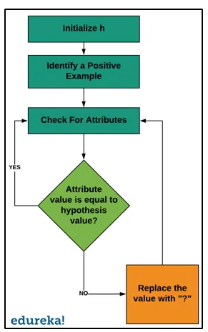
How Does It Work?

Slide 72
The process starts with initializing ‘h’ with the most specific hypothesis, generally, it is the first positive example in the data set.
We check for each positive example. If the example is negative, we will move on to the next example but if it is a positive example we will consider it for the next step.
We will check if each attribute in the example is equal to the hypothesis value.
If the value matches, then no changes are made.
If the value does not match, the value is changed to ‘?’.
We do this until we reach the last positive example in the data set.

Slide 73
Limitations of Find-S Algorithm
There is no way to determine if the hypothesis is consistent throughout the data.
Inconsistent training sets can actually mislead the Find-S algorithm since it ignores the negative examples.
The find-S algorithm does not provide a backtracking technique to determine the best possible changes that could be done to improve the resulting hypothesis.

Slide 74
Important Representation :
? indicates that any value is acceptable for the attribute.
specify a single required value ( e.g., Cold ) for the attribute.
ϕ indicates that no value is acceptable.
The most general hypothesis is represented by: {?, ?, ?, ?, ?, ?}
The most specific hypothesis is represented by:
{ϕ, ϕ, ϕ, ϕ, ϕ, ϕ}

Slide 75
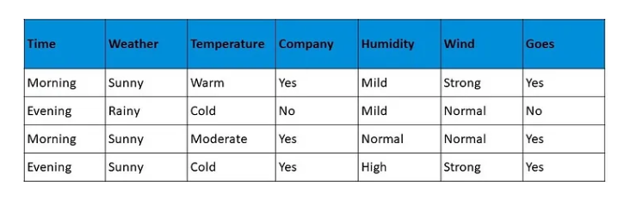
Example-1
The concept of this particular problem will be on what days does a person likes to go on a walk.

Slide 76
Example of a Concept Learning task
Concept: Good Days for Water Sports (values: Yes, No)
Attributes/Features:
Sky (values: Sunny, Cloudy, Rainy)
AirTemp (values: Warm, Cold)
Humidity (values: Normal, High)
Wind (values: Strong, Weak)
Water (Warm, Cool)
Forecast (values: Same, Change)
Example of a Training Point:
<Sunny, Warm, High, Strong, Warm, Same, Yes>
class

Slide 77
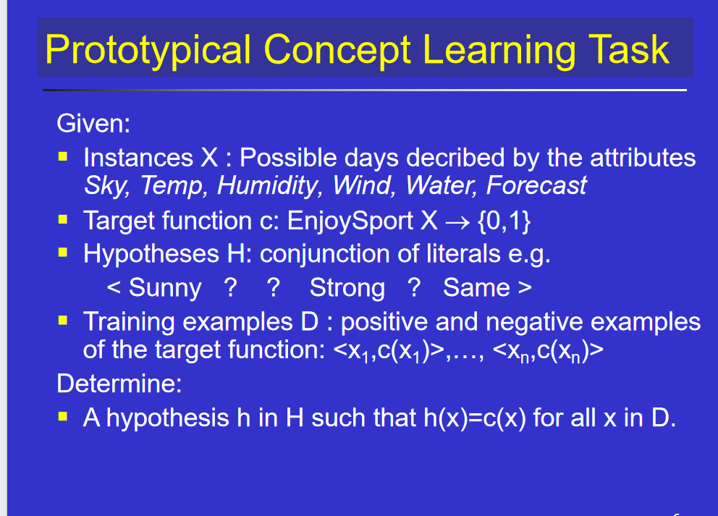
Hypothesis h is a conjunction of constraints on attributes

Slide 78
Terminology and Notation
The set of items over which the concept is defined is called the set of instances (denoted by X)
The concept to be learned is called the Target Concept (denoted by c: X--> {0,1})
The set of Training Examples is a set of instances, x, along with their target concept value c(x).
Members of the concept (instances for which c(x)=1) are called positive examples.
Nonmembers of the concept (instances for which c(x)=0) are called negative examples.
H represents the set of all possible hypotheses. H is determined by the human designer’s choice of a hypothesis representation.
The goal of concept-learning is to find a hypothesis h:X --> {0,1} such that h(x)=c(x) for all x in X.

Slide 79
h0 = {‘Morning’, ‘Sunny’, ‘Warm’, ‘Yes’, ‘Mild’, ‘Strong’}
h1= {‘Morning’, ‘Sunny’, ‘?’, ‘Yes’, ‘?’, ‘?’}
h2 = {‘?’, ‘Sunny’, ‘?’, ‘Yes’, ‘?’, ‘?’}

Slide 80
Looking at the data set, we have six attributes and a final attribute that defines the positive or negative example. In this case, yes is a positive example, which means the person will go for a walk.
So now, the general hypothesis is:
h0 = {‘Morning’, ‘Sunny’, ‘Warm’, ‘Yes’, ‘Mild’, ‘Strong’}
This is our general hypothesis, and now we will consider each example one by one, but only the positive examples.

Slide 81
Example -2
Find-S: Maximally Specific Hypothesis Solved Example

Slide 82
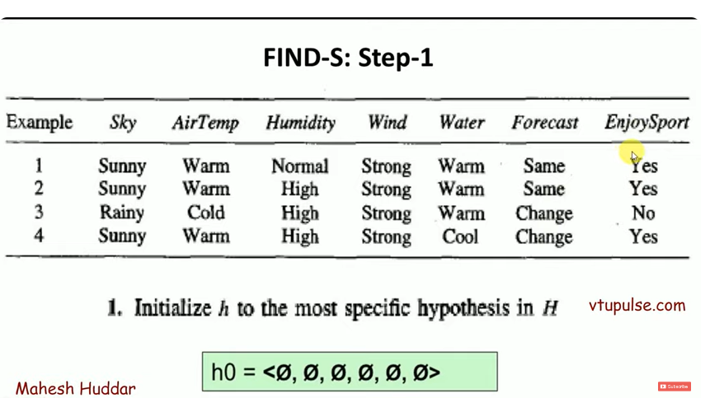

Slide 83
Example of a Concept Learning task
Chosen Hypothesis Representation:
Conjunction of constraints on each attribute where:
“?” means “any value is acceptable”
“0” means “no value is acceptable”
Example of a hypothesis: <?,Cold,High,?,?,?>
(If the air temperature is cold and the humidity high then it is a good day for water sports)
class
Most General Hypothesis: Everyday is a good day for water sports <?,?,?,?,?,?>
Most Specific Hypothesis: No day is a good day for water sports <0,0,0,0,0,0>

Slide 84
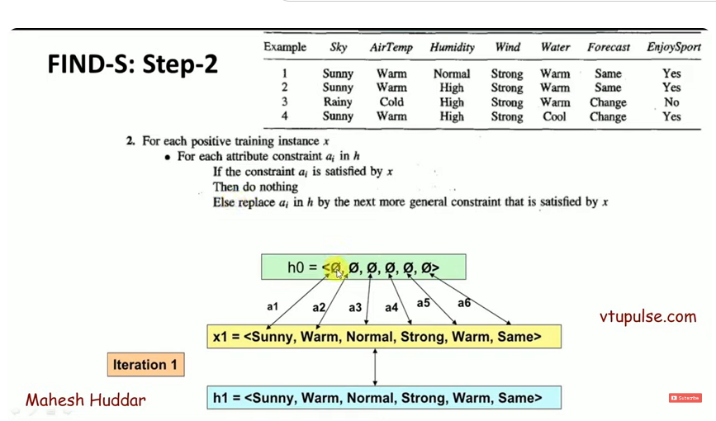

Slide 85
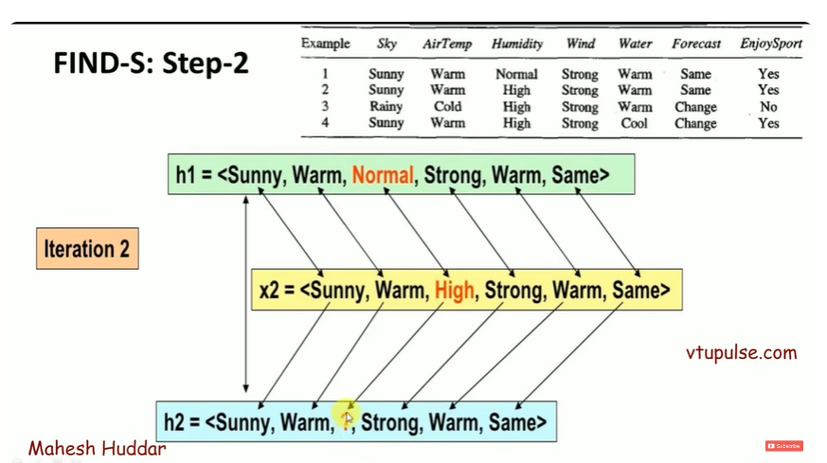

Slide 86
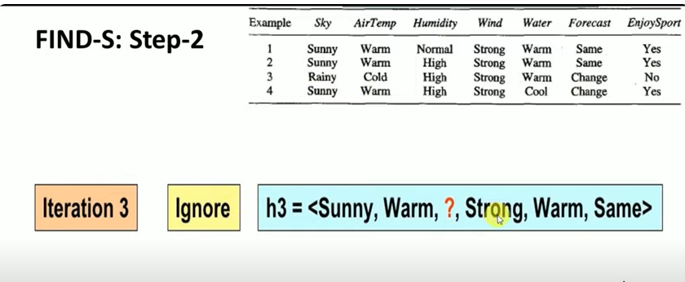

Slide 87
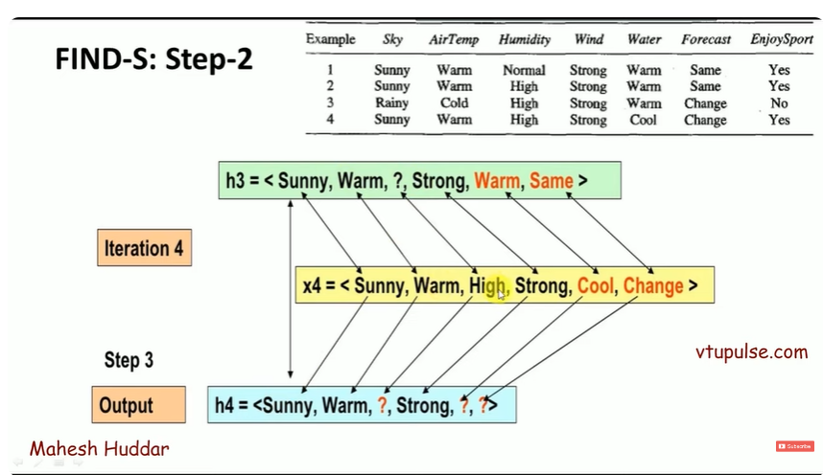

Slide 88
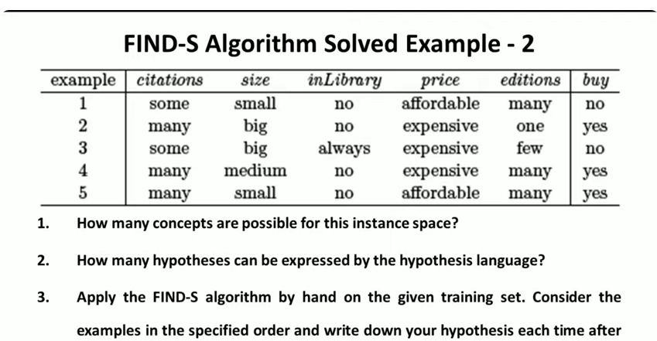

Slide 89
Example -3

Slide 90
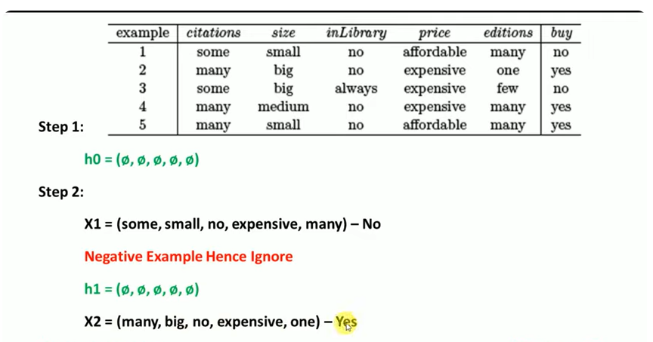

Slide 91


Slide 92


Slide 93


Slide 94
Candidate Elimination Algorithm
Step 1:Initialize G and S as Most general and specific Hypothesis.
Step 2: For each example,e
If e is +ve:
Make specific hypothesis more general(Find-S)Top to Bottom
Else:
E is –ve:
Make general hypothesis to more specific(Bottom to ToP)

Slide 95
Candidate Elimination Algorithm
The candidate elimination algorithm incrementally builds the version space given a hypothesis space H and a set E of examples. The examples are added one by one; each example possibly shrinks the version space by removing the hypotheses that are inconsistent with the example.
The candidate elimination algorithm does this by updating the general and specific boundary for each new example.
Consider both positive and negative examples.
Actually, positive examples are used here as the Find-S algorithm (Basically they are generalizing from the specification).
While the negative example is specified in the generalizing form.

Slide 96
Candidate Elimination Algorithm
Step1: Load Data set
Step2: Initialize General Hypothesis and Specific Hypothesis.
Step3: For each training example
Step4: If example is positive example
if attribute_value == hypothesis_value:
Do nothing
else:
replace attribute value with '?' (Basically generalizing it)
Step5: If example is Negative example
Make generalize hypothesis more specific.

Slide 97

Candidate elimination Algorithm

Slide 98
S0: (ø, ø, ø, ø, ø, ø) Most Specific Boundary
G0: (?, ?, ?, ?, ?, ?) Most Generic Boundary
The first example is positive, the hypothesis at the specific boundary is inconsistent, hence we extend the specific boundary, and the hypothesis at the generic boundary is consistent hence we retain it.
S1: (Sunny,Warm, Normal, Strong, Warm, Same)
G1: (?, ?, ?, ?, ?, ?)

Slide 99
The second example in positive, again the hypothesis at the specific boundary is inconsistent, hence we extend the specific boundary, and the hypothesis at the generic boundary is consistent hence we retain it.
S2: (Sunny,Warm, ?, Strong, Warm, Same)
G2: (?, ?, ?, ?, ?, ?)
The third example is negative, the hypothesis at the specific boundary is consistent, hence we retain it, and hypothesis at the generic boundary is inconsistent hence we write all consistent hypotheses by removing one “?” (question mark) at time.

Slide 100
The third example is negative, the hypothesis at the specific boundary is consistent, hence we retain it, and hypothesis at the generic boundary is inconsistent hence we write all consistent hypotheses by removing one “?” (question mark) at time.
S3: (Sunny,Warm, ?, Strong, Warm, Same)
G3: (Sunny,?,?,?,?,?) (?,Warm,?,?,?,?) (?,?,?,?,?,Same)
The fourth example is positive, the hypothesis at the specific boundary is inconsistent, hence we extend the specific boundary, and the consistent hypothesis at the generic boundary are retained.

Slide 101
S4: (Sunny, Warm, ?, Strong, ?, ?)
G4: (Sunny,?,?,?,?,?) (?,Warm,?,?,?,?)

Slide 102


Slide 103


Slide 104


Slide 105


Slide 106


Slide 107


Slide 108


Slide 109
Initially : G = [[?, ?, ?, ?, ?, ?], [?, ?, ?, ?, ?, ?], [?, ?, ?, ?, ?, ?],
[?, ?, ?, ?, ?, ?], [?, ?, ?, ?, ?, ?], [?, ?, ?, ?, ?, ?]]
S = [Null, Null, Null, Null, Null, Null]
For instance 1 : <'sunny','warm','normal','strong','warm ','same'> and positive output.
G1 = G
S1 = ['sunny','warm','normal','strong','warm ','same']
For instance 2 : <'sunny','warm','high','strong','warm ','same'> and positive output.
G2 = G
S2 = ['sunny','warm',?,'strong','warm ','same']
For instance 3 : <'rainy','cold','high','strong','warm ','change'> and negative output.
G3 = [['sunny', ?, ?, ?, ?, ?], [?, 'warm', ?, ?, ?, ?], [?, ?, ?, ?, ?, ?],
[?, ?, ?, ?, ?, ?], [?, ?, ?, ?, ?, ?], [?, ?, ?, ?, ?, 'same']]
S3 = S2
For instance 4 : <'sunny','warm','high','strong','cool','change'> and positive output.
G4 = G3
S4 = ['sunny','warm',?,'strong', ?, ?]
At last, by synchronizing the G4 and S4 algorithm produce the output.

Slide 110


Slide 111

Example-2

Slide 112
S0: (0, 0, 0) Most Specific Boundary
G0: (?, ?, ?) Most Generic Boundary
The first example is negative, the hypothesis at the specific boundary is consistent, hence we retain it, and the hypothesis at the generic boundary is inconsistent hence we write all consistent hypotheses by removing one “?” at a time.
S1: (0, 0, 0)
G1: (Small, ?, ?), (?, Blue, ?), (?, ?, Triangle)

Slide 113
The second example is negative, the hypothesis at the specific boundary is consistent, hence we retain it, and the hypothesis at the generic boundary is inconsistent hence we write all consistent hypotheses by removing one “?” at a time.
S2: (0, 0, 0)
G2: (Small, Blue, ?), (Small, ?, Circle), (?, Blue, ?), (Big, ?, Triangle), (?, Blue, Triangle)
The third example is positive, the hypothesis at the specific boundary is inconsistent, hence we extend the specific boundary, and the consistent hypothesis at the generic boundary is retained and inconsistent hypotheses are removed from the generic boundary.

Slide 114
S3: (Small, Red, Circle)
G3: (Small, ?, Circle)
The fourth example is negative, the hypothesis at the specific boundary is consistent, hence we retain it, and the hypothesis at the generic boundary is inconsistent hence we write all consistent hypotheses by removing one “?” at a time.
S4: (Small, Red, Circle)

Slide 115
G4: (Small, ?, Circle)
The fifth example is positive, the hypothesis at the specific boundary is inconsistent, hence we extend the specific boundary, and the consistent hypothesis at the generic boundary is retained and inconsistent hypotheses are removed from the generic boundary.
S5: (Small, ?, Circle)
G5: (Small, ?, Circle)
S: G: (Small, ?, Circle)

Slide 116
Inductive Bias
In machine learning, inductive bias refers to the assumptions or preconceptions that a model or algorithm makes about the underlying distribution of data.
These biases can influence the model’s ability to learn from a given dataset and can affect the performance of the model on new, unseen data. A model with too strong of an inductive bias may fail to capture the complexity of the underlying data, while a model with too weak of an inductive bias may overfit the training data.
There are several ways to describe the inductive bias of a model, including:
the choice of model architecture
the selection of features
the type of regularization applied to the model.
When a child learns to recognize animals, they may start with a bias that animals have four legs. This bias helps them identify a wide range of animals like dogs, cats, cows, etc., but it may fail when confronted with animals like snakes or birds.

